Slide 1

Tree Yourself
IWD Avanade Hackathon 2023

Slide 2

What habits would you like to improve?
How would you like your family life to be in the future?
Think about the people you admire, which qualities do they possess that you wish you had?
Notes:
Before I start showing you our product I want you to think about the questions in the slide
Please stop the video and think about them
Do you have a clear answer to this questions?
Did you ever write the results down?
These questions are part of the so called writing intervention. Writing intervention means reflecting your ambitions and dreams guided through questions

Slide 3
Positive impacts of a writing intervention
Gender and minority equality
reemployment
grade average
memory
psychological wellbeing
health
Notes:
But why a writing intervention?
There are More than 2000 studies about the positive impacts of a writing intervention, foremost proving that it erased the gender and ethnic miniroty achivement gap completley! Many more positive effects can be gleaned from this slide.

Slide 4
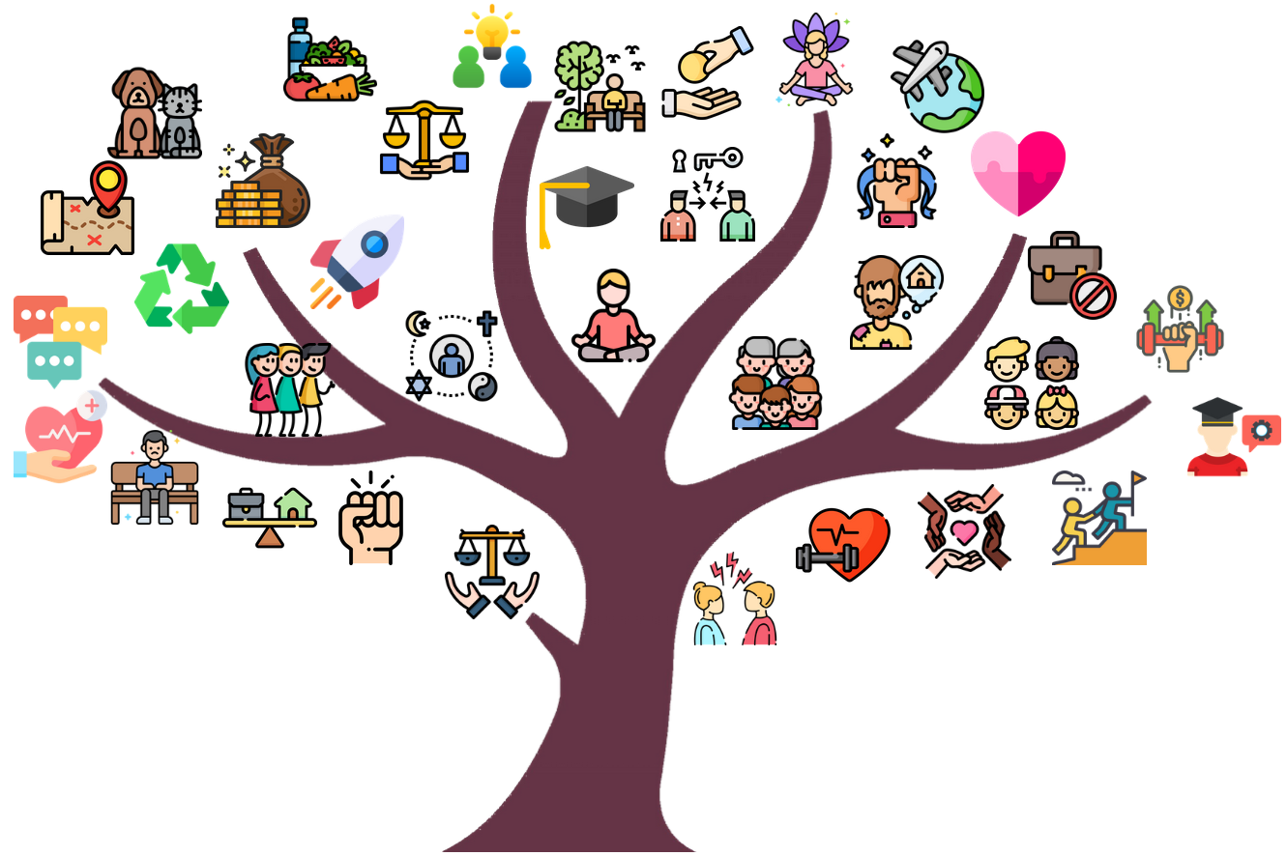
TreeYourself
Notes:
TreeYourself is a writing intervention, where users first answer 10 questions.
The answers are analyzed by a NLP Algorithm and mapped to preselected tags
These tags are displayed in a beautiful tree, where the user can see all of her dreams at once.

Slide 5
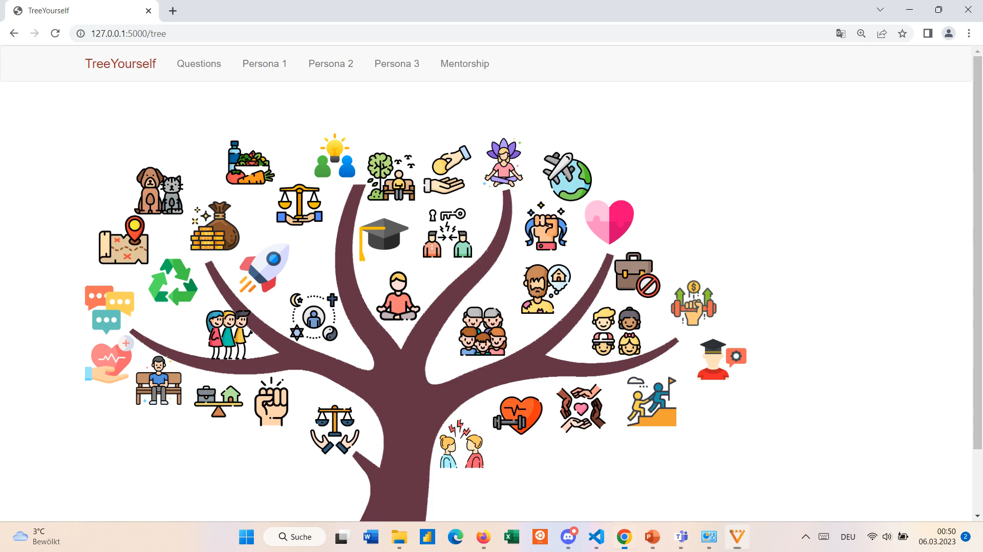

Slide 6
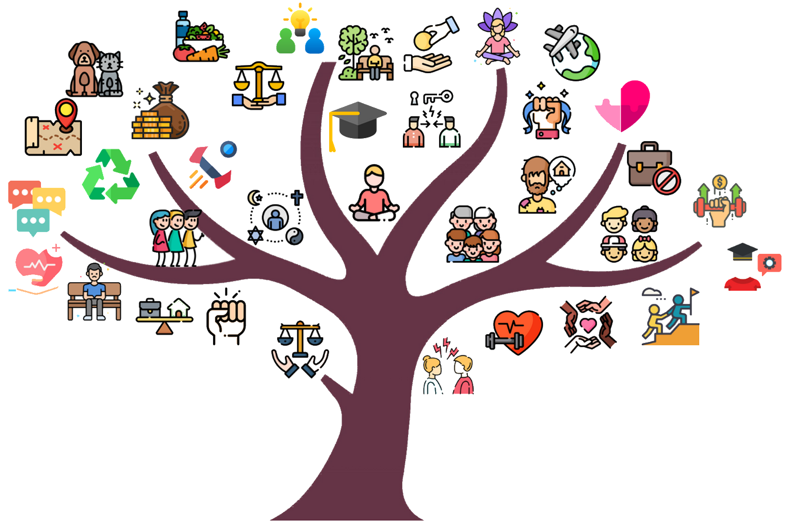
Challenge: Avanade 'Reducing Bias'
confidence gap (33%): Men are more successful in interviews
After writing intervention women performed 30 % better in contests
Boost confidence: women can create a clear vision using TreeYourself before an interview​
Notes:
We want to address 2 challenges.
The first challenge is addressed by reducing the confidence gap between genders.
After wiriting intervention woman performed 30% better in contests
Avanade can send women the link to TreeYourself before the job interview to boost their confidence

Slide 7
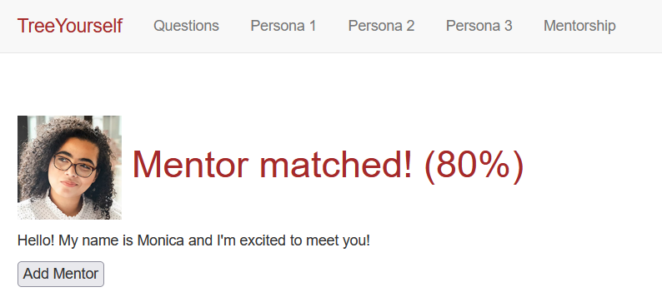
Challenge: Women in Cloud 'Allyship'
Problem: Mentors usually randomly assigned
Map mentor and mentee based on common dreams and wishes
Notes:
Our product helps assigning the right mentors for a person
There are a lot of mentor programs already, but the problem is that they don‘t know either mentor nor mentee
TreeYourself can map the mentees to their perfect mentor based on their wishes and dreams.

Slide 8
Thank you for your attention!
https://github.com/HoergerL/TreeYourself
Notes:
So there is only one thing left to do, try tree yourself and gain all the positive effects mentioned in the presentation

